Slide 1
Design Patterns
A common way to look at software

Slide 2
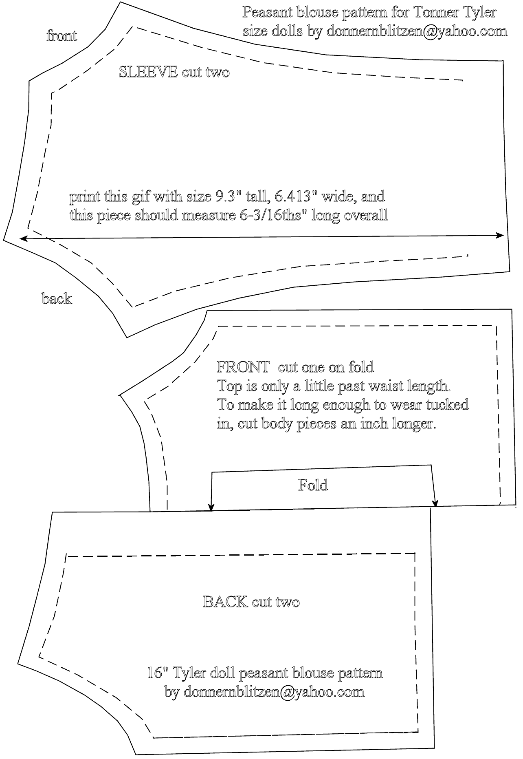
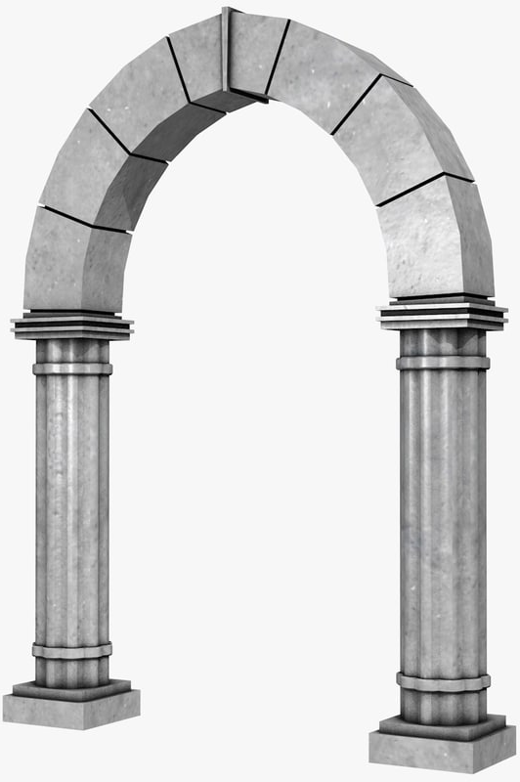
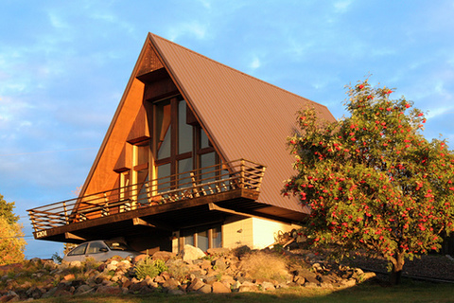
Design Patterns are All Around Us

Slide 3
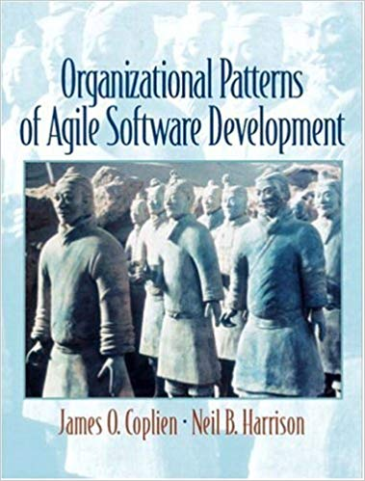
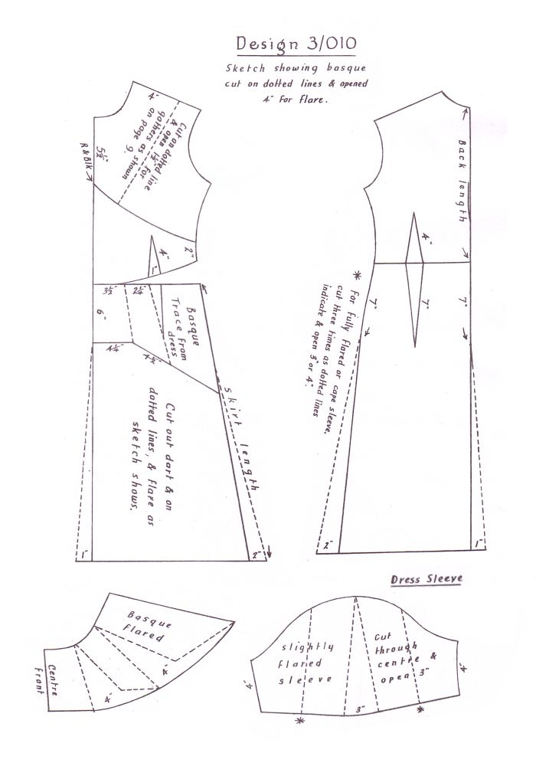


Consider a dress pattern
I like to relate this definition to dress patterns. I could tell you how to make a dress by specifying the route of a scissors through a piece of cloth in terms of angles and lengths of cut. Or, I could give you a pattern. Reading the specification, you would have no idea what was being built or if you had built the right thing when you were finished. The pattern foreshadows the product: it is the rule for making the thing, but it is also, in many respects, the thing itself.

Slide 4


Patterns exist in Engineering and Architecture
"Each pattern describes a problem which occurs over and over again in our environment, and then describes the core of the solution to that problem, in such a way that you can use this solution a million times over, without ever doing it the same way twice” – Christopher Alexander
Uses patterns to capture and express classic architectural knowledge. Usually the pattern is a compromise that balances all forces advantageously.

Slide 5
T.S. Eliot
Immature poets imitate; mature poets steal; bad poets deface what they take, and good poets make it into something better, or at least something different.
The good poet welds his theft into a whole of feeling which is unique, utterly different from that from which it was torn; the bad poet throws it into something which has no cohesion.
Design patterns let us build quickly with a pattern that another software designer will recognize quickly.

Slide 6
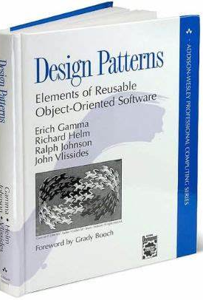
Gang Of Four (GOF)
Published in 1994, this book led the way for others to define software patterns. The four co-authors are known as the gang of four (GOF).
Worth Buying!

Slide 7
Types of Patterns
Architectural – “big picture” patterns – client/server, three tiered, serverless, service oriented architecture (SOA)
Design Patterns – “middle picture” patterns – usually language agnostic describing class or object designs – factory, singleton, visitor
Idiomatic Patterns – language specific patterns that are frequently seen in a particular language – for (int i=0;i<N;i++) or Duff’s Device

Slide 8
Elements of a Design Pattern
Name – the name is important because it becomes part of our design vocabulary (“Make this class a Singleton Factory”)
Problem – the problem that this design pattern solves
Solution – description of the solution (sample code, UML)
Consequences/Tradeoffs/Warnings – things to be aware of when implementing this design

Slide 9
Design Pattern Subcategories
Behavioral – define the behavior of a portion of the code
Creational – define how objects are created
Structural – aggregating classes or objects to make larger structures

Slide 10
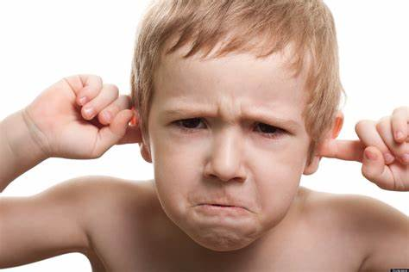
Behavior Patterns

Slide 11
Behavioral : Visitor
Problem: Large, unchanging set of classes. Need to perform same action(s) on each of them.
Solution: Make each class conform to an interface (IVisitable) that has one method: void Accept (IVisitor v). Each visitor class conforms to IVisitor.
Consequences:
Adding new operations is easy; adding new classes is harder.
Related behavior is stored in visitor. Visitor can store state.
Example: CodeGenerator class that visits AST nodes

Slide 12
Behavioral : Observer
Problem: One or more classes (observed) need to let another (observer) know when they change
Solution: Add “Attach” and “Detach” methods to the observed, taking an IObserver as a parameter. The observed keeps a list of observers. When observed object changes, it iterates over the observers, calling an “Update” method.
Consequences: Loose coupling, supports broadcast, cascading updates
Example: Fuel gauge UI component observes the Fuel Tank class

Slide 13
Behavioral : Mediator
Problem: One or more classes (clients) need to communicate with many classes to do similar work. It doesn’t make sense to use a sub-classing scheme due to complex logic.
Solution: Create a mediator class that communicates with the many classes. Each client talks only to the mediator class.
Consequences: Avoids sub-classing, clients are simpler and more reusable, centralizes control.
Example: A game can be multiplayer via Bluetooth, internet or direct cable connection. A mediator abstracts this from the game.

Slide 14
Behavioral : Template Method
Problem: Some algorithm has a portion that could be implemented differently, but the rest of the algorithm shouldn’t change.
Solution: Make the algorithm call a method defined via higher order function or inheritance.
Consequences: Code reuse, algorithm doesn’t break.
Example: Quicksort needs a “comparison” method

Slide 15
Behavioral : Chain of Responsibility
Problem: For a given event/message, any of a number of objects could respond.
Solution: Give each responder a “next responder” reference. If responder can’t handle message, it should pass the message on to the next.
Consequences: Hard to know who actually responded.
Example: OnClick events in a user interface

Slide 16
Behavioral : Interpreter
Problem: Application needs to run arbitrary code
Solution: Implement a lexer/parser/interpreter.
Consequences: Significant effort.
Example: Games with scripting for “AI”, JavaScript in browser

Slide 17
Behavioral : Memento
Problem: Need to store and retrieve the current state of the application.
Solution: Create a class to hold the current state. The application can populate/restore from this class. This class can be streamed to disk.
Consequences: Single place in the application to hold state for storage.
Example: Nearly every iOS/Android app

Slide 18
Behavioral : State
Problem: An object can have different behaviors based on its current state.
Solution: Create classes for the behaviors. Allow these behaviors to change which behavior the parent object has.
Consequences: Parent object is unaware of states. States manage state transitions.
Example: Game AI – monsters go from attack to defend based on distance from player.

Slide 19
Behavioral : Strategy
Problem: Different algorithms that do the same thing need to be swapped out for each other.
Solution: Define a single interface and make each implementation adhere to that interface.
Consequences: Easy switching between implementations.
Example: Simple sort algorithms work faster on a small data set. More complex algorithms are faster on a large data set. Use strategy to decide.

Slide 20
Behavioral : Iterator
Problem: Access each element of a collection without exposing internal details of the collection.
Solution: Define a class with an operation that gets the next element.
Consequences: Information hiding.
Example: Java/C# Iterator class (built-in)

Slide 21
Behavioral : Visitor
Problem: Need to perform an action for every element in a collection.
Solution: Define a class with an operation that works on a single element. Call this operation once for every element in collection.
Consequences: Easy to have many visitors over data structure.
Example: Code generation visits each AST node

Slide 22

Creational Patterns

Slide 23
Creational : Abstract Factory
Problem: You have multiple implementations that you want to choose one of, at run time.
Solution: Create an abstract class with a static method to create one of the implementations.
Consequences: Single location to update with implementations.
Example: Support two different vendors for text messages.

Slide 24
Creational : Factory
Problem: You need more control over creating of classes (method name, memory allocation, choosing which subclass to create)
Solution: Create a static method to create an instance.
Consequences: Can be overridden by subclasses, name can be chosen.
Example: In a game, the player is limited to 100 bullets on screen at a time. Allocate array of 100 objects. Reuse them using a factory method.

Slide 25
Creational : Singleton
Problem: You want a single, global instance of an object
Solution: Make the constructor private (or protected). Create a static method “getInstance” that make a new one (first time) or returns the previously created instance.
Consequences: All of the risks of a global, more flexible than a static class
Example: A class to record all operations within my app (logger)

Slide 26
Creational : Adaptor
Problem: You have an object but you need a different interface
Solution: Create a class that uses the given object (composition), exposing the interface that you need.
Consequences: Allows many implementations using very different objects.
Example: Support two different vendors for text messages.

Slide 27
Creational : Prototype
Problem: You need to make an object based on another
Solution: Create an interface with a “Clone” method. Adhere to this interface and implement Clone method.
Consequences: Be aware of Shallow vs Deep copies
Example: copy/paste in a drawing program.

Slide 28
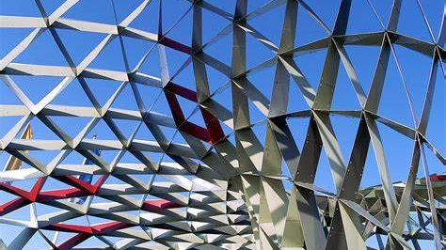
Structural Patterns

Slide 29
Structural : Façade
Problem: A complex or changeable interface needs to be hidden
Solution: Create one or more classes with an interface of your design that use composition to implement the actions.
Consequences: Your interface isolates the rest of the code from the complexity of the original interface.
Example: A filesystem Façade that hides the underlying OS

Slide 30
Structural : Proxy
Problem: You need something more than a reference to a class (distributed system, reference counting)
Solution: Create a class with the same interface that passes calls through to the original class.
Consequences: Hides complexity from client systems
Example: I want to put my intense computations on another CPU. I make a proxy on my main CPU that uses network calls to communicate.

Slide 31
Structural : Decorator (aka wrapper)
Problem: You have a class that does something. You want to add functionality but that functionality can be removed.
Solution: Create an abstract class (AD) that inherits from the same parent class as the original(OC). AD contains an instance of OC and implements the methods of OC by calling OC and adding functionality.
Consequences: Breaks substitutability, lots of repetitive code
Example: A database class that adds logging

Slide 32
Structural : Composite
Problem: You want to group objects but treat them as a single object.
Solution: Make an object that follows the same interface as a single object and contains a collection of single objects. Implement each Method by calling Method on each object in the collection.
Consequences: Do all Methods make sense for all Objects? Hides big-O.
Example: A drawing program with “group” functionality.

Slide 33
Behavioral : Command
Problem: Many ways to invoke command, want one unified process.
Solution: Create an class that represents commands. Each invocation produces a command class and is fed to a “receiver” for processing.
Consequences: Grouping, undo/redo, logging, decouples action from execution.
Example: Drawing program that can run from menu, keyboard shortcut, scripting language

Slide 34
Creational : Flyweight
Problem: You need huge numbers of objects, many the same.
Solution: Create a factory to create the objects. Have the factory cache existing objects and return those first (like singleton)
Consequences: Fewer objects created. Objects should be read-only.
Example: Number class in a pure object oriented language.

Slide 35
Creational : Abstract Factory
Problem: You have multiple implementations that you want to choose one of, at run time.
Solution: Create an abstract class with a static method to create one of the implementations.
Consequences: Single location to update with implementations.
Example: Support two different vendors for text messages.

Slide 36
Patterns Roundup
These are OBSERVED patterns – solutions that software architects have found themselves building over and over. They are not “right” or “wrong”.
Learning these gives you a vocabulary and some knowledge of “best practices” for building software.
Beware of trying to force everything to fit a pattern – sometimes they are not a good fit.

